Slide 1

Residential meeting
Year 6
2025

Slide 2
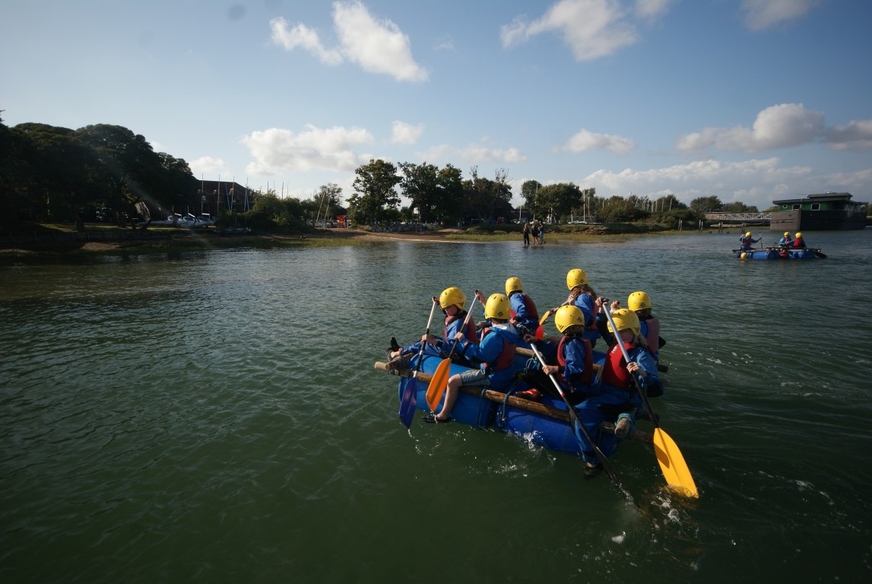
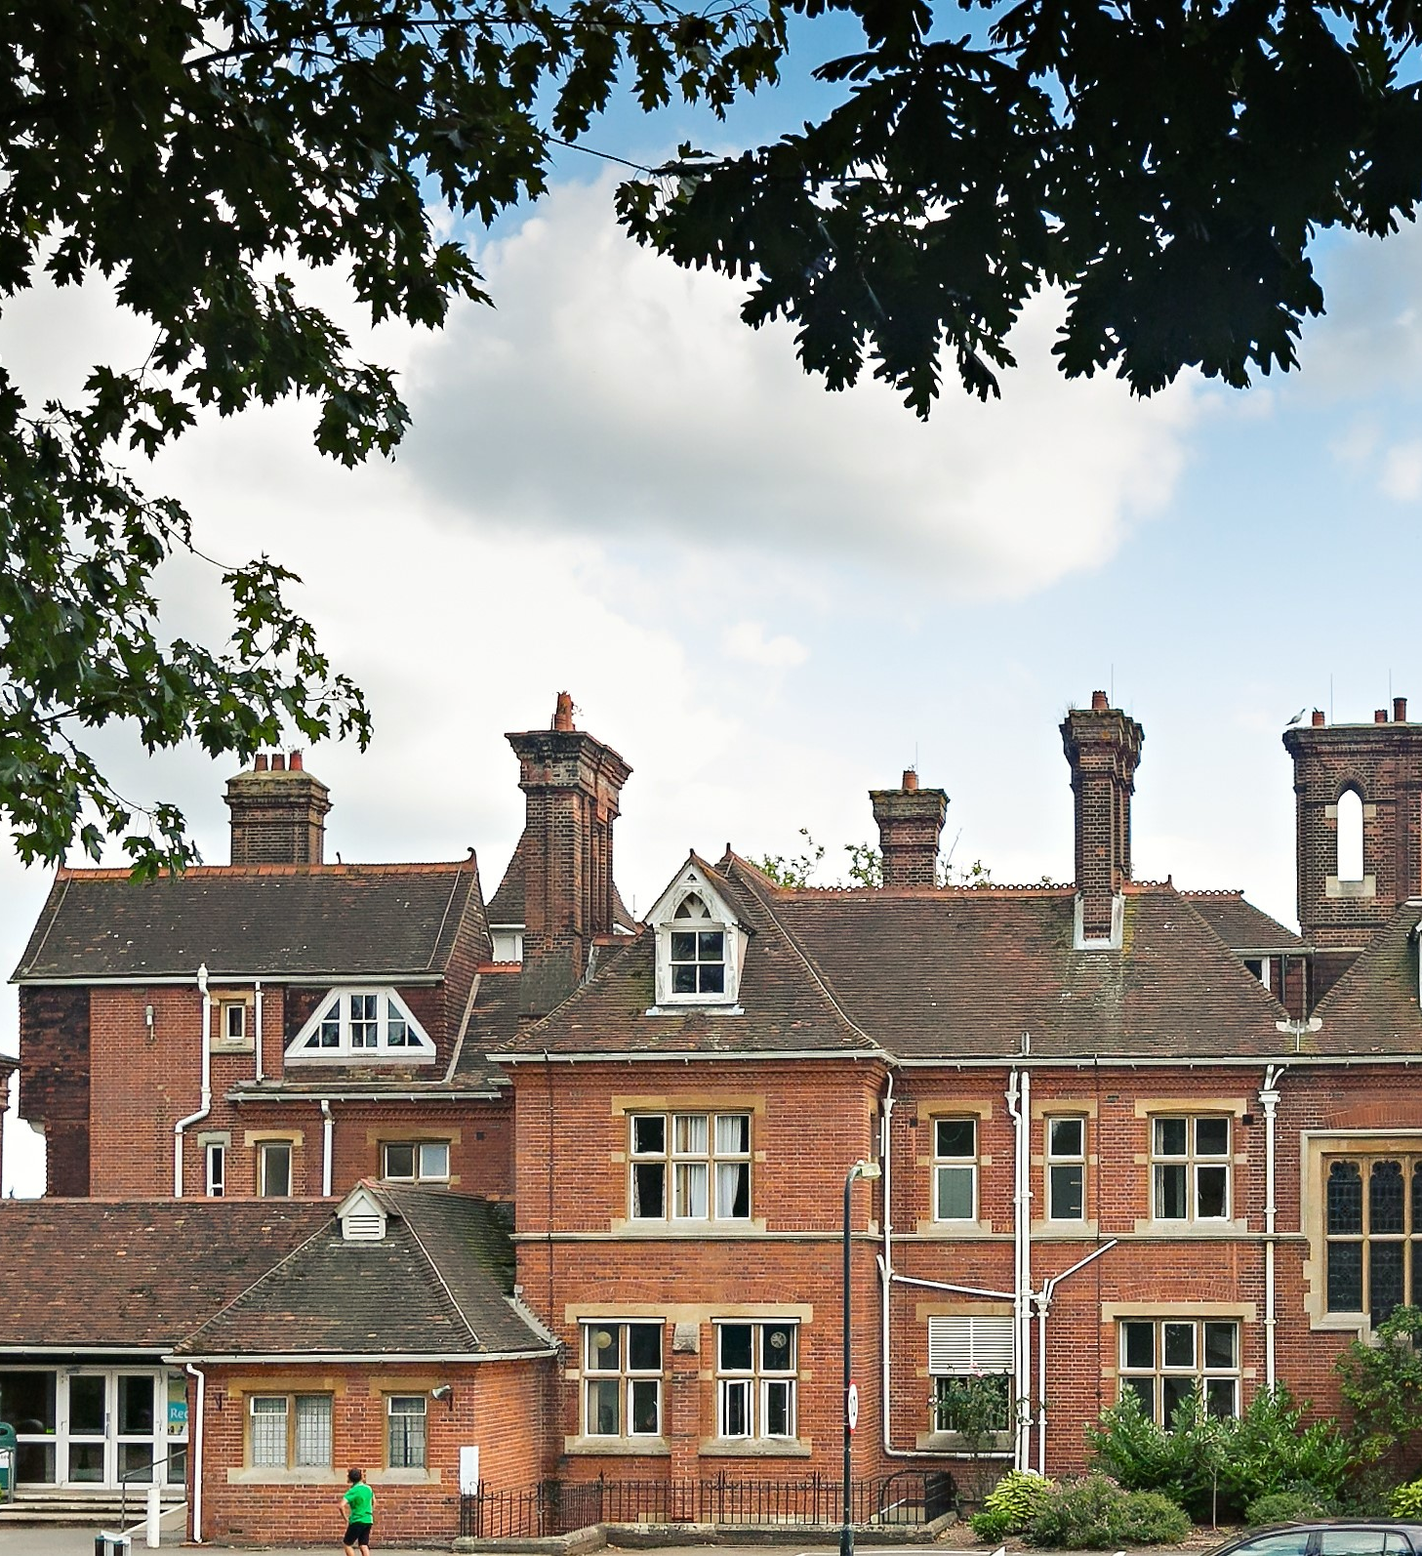
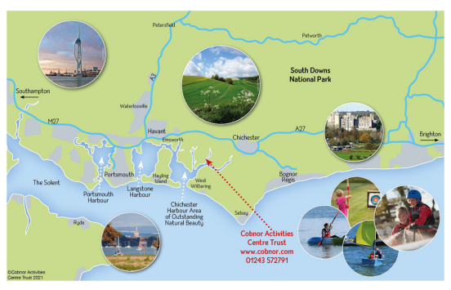
Background info
When? July and September 2025
Where? Cobnor Activities Centre, Chichester

Slide 3
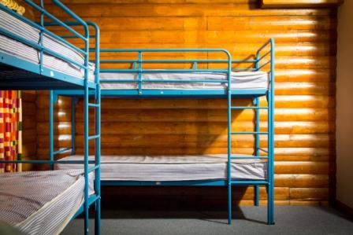
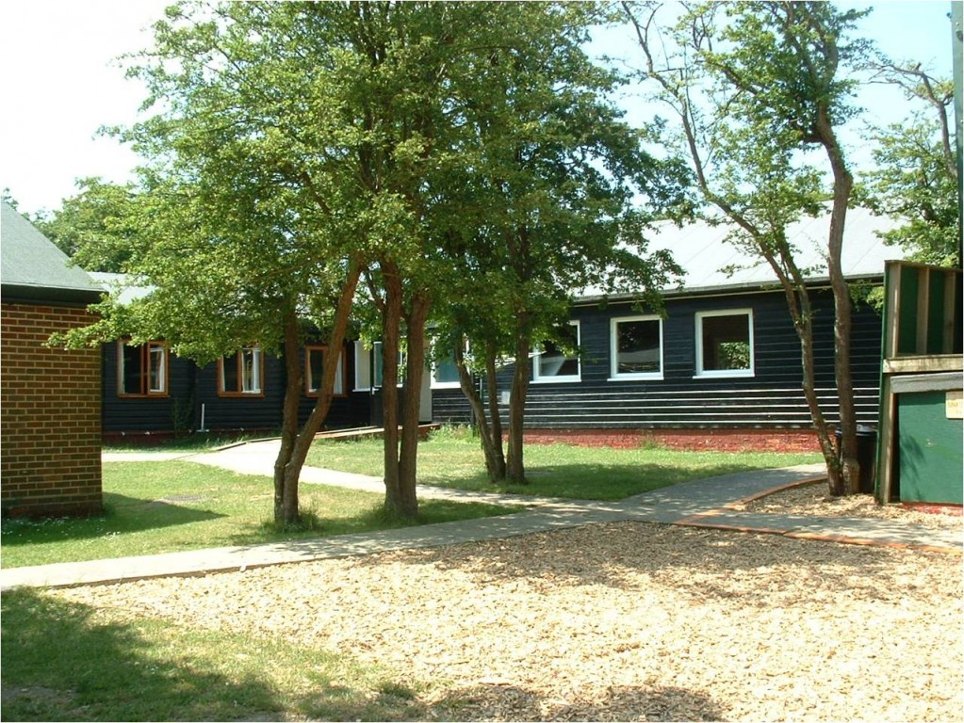
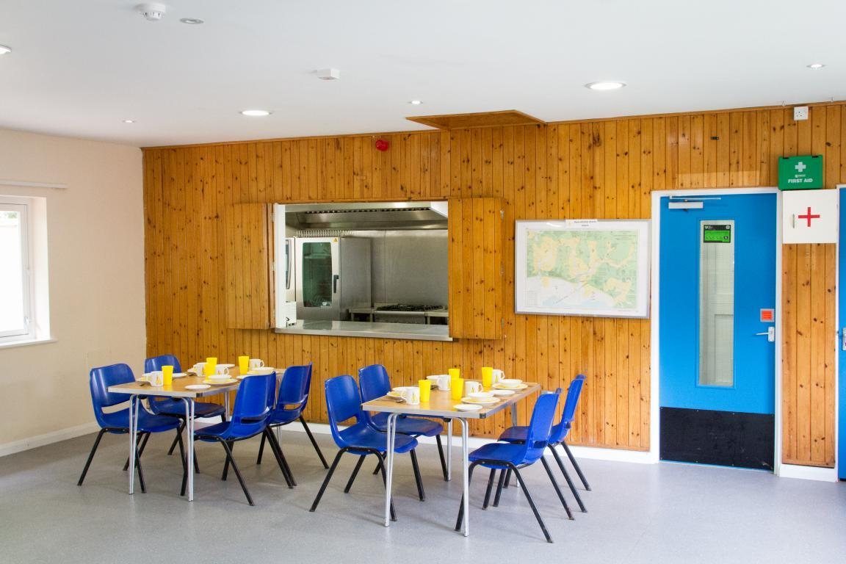
Included in the cost
Travel to and from the centre
3 meals a day
Accommodation
Range of activities
Professional supervision, instruction and equipment
Your child will need to bring a SLEEPING BAG & a PILLOW

Slide 4

Activities
Water sports included

Slide 5
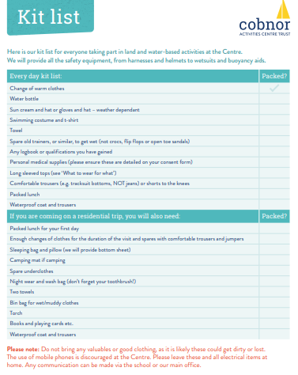

Kit list

Slide 6

Electronic devices are strictly forbidden. This is for the safeguarding of all children
Adults will be monitoring and anyone found with a device will have it confiscated and a phone call home will be made.

Slide 7

Spending money
This should be in a sealed, named envelope
Your child’s group leader will be given this before departure

Slide 8
Medication
All medication will need to be in a plastic, named bag. Please ensure that instructions are also clearly marked; how and when it should be taken
Those who suffer from travel sickness should take a travel sickness tablet 1 hour before departure. Alternatively, they can wear their anti-sickness bands. Can an extra be provided for our return.
Please inform us if your child has any personal needs that might require our attention

Slide 9
Grouping
There will be 8/4 children per room, (these will be decided by class teachers). Girls and boys will be in separate rooms and areas
During the day, children will be put into groups led by an adult

Slide 10
What to do now....
Closer to the date a ‘kit list’ and other relevant information will be handed out,- you will also receive first aid and menu choice forms.
Medication details need to be passed with named medication to supervising adults
(allergy tablets/syrup etc)
Don’t forget sleeping bags and pillow
Black dustbin bag for wet & dirty clothes
List for child to tick off when packing for return
Remember their clothes will get dirty and wet SO PLEASE MAKE SURE THAT NOTHING IS EXPENSIVE OR FANCY AS THEY STAND A GOOD CHANCE OF GETTING DAMAGED.

