Slide 1
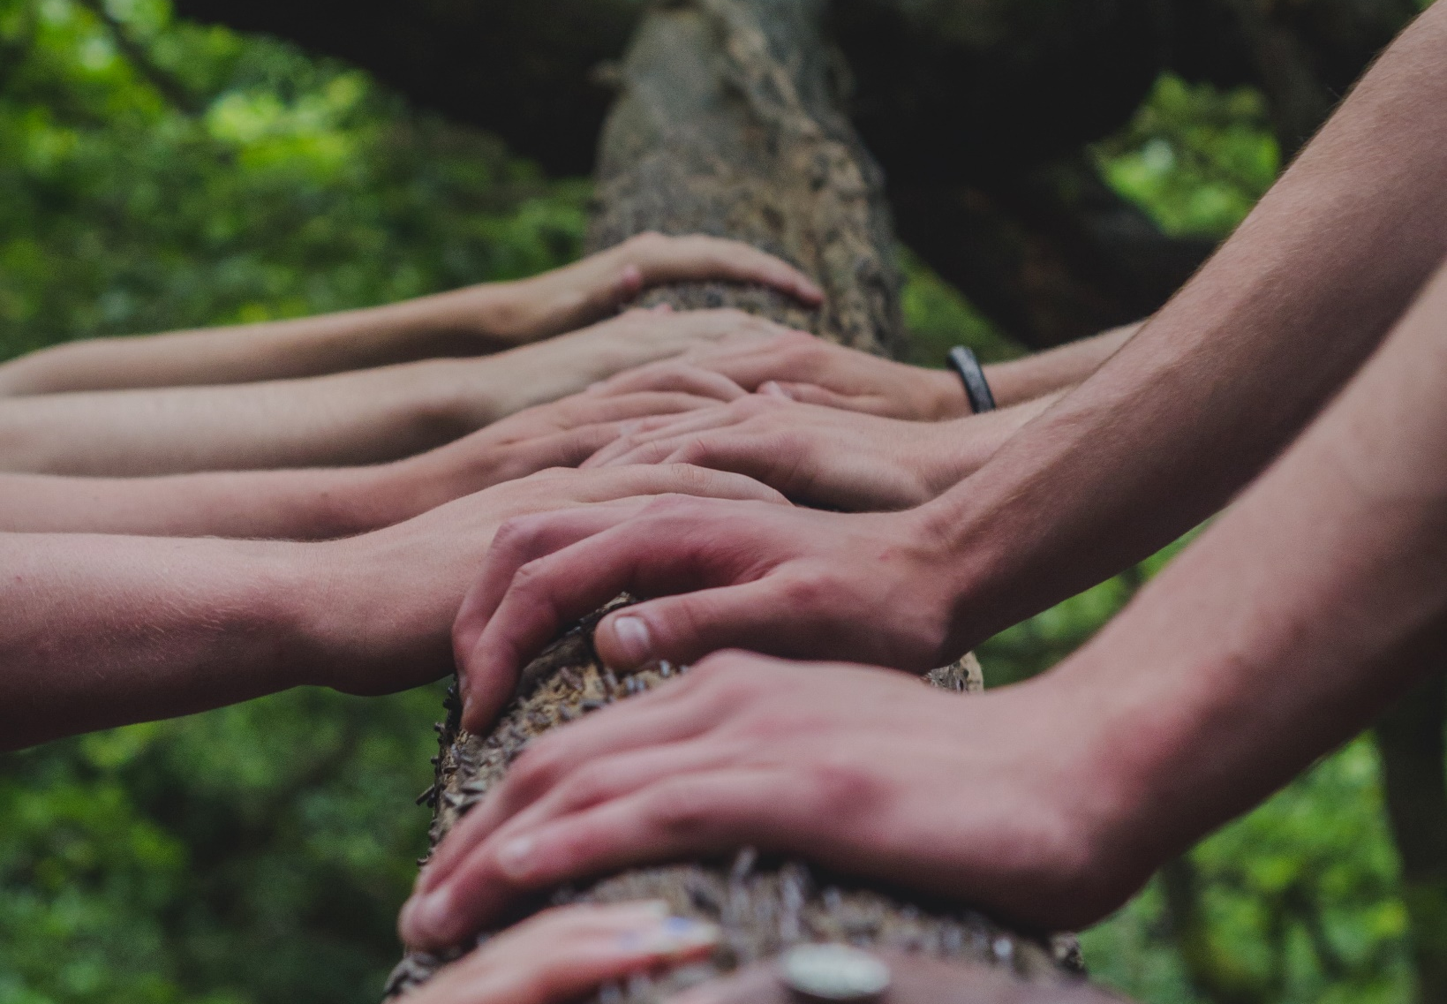
Positive and healthy relationships
Y6 Lesson 3

Slide 2
Learning objective
We are learning about positive, healthy relationships
Learning outcomes
I can identify different kinds of loving relationships.
I can describe the qualities that enable these relationships to flourish.
I can explain the purpose of mutual respect in close relationships.
I can recognise how relationships may change or end and what can help to manage this.

Slide 3

Ground rules

Slide 4

Relationships
Some features of positive healthy relationships are…..
Some different types of relationships are……

Slide 5
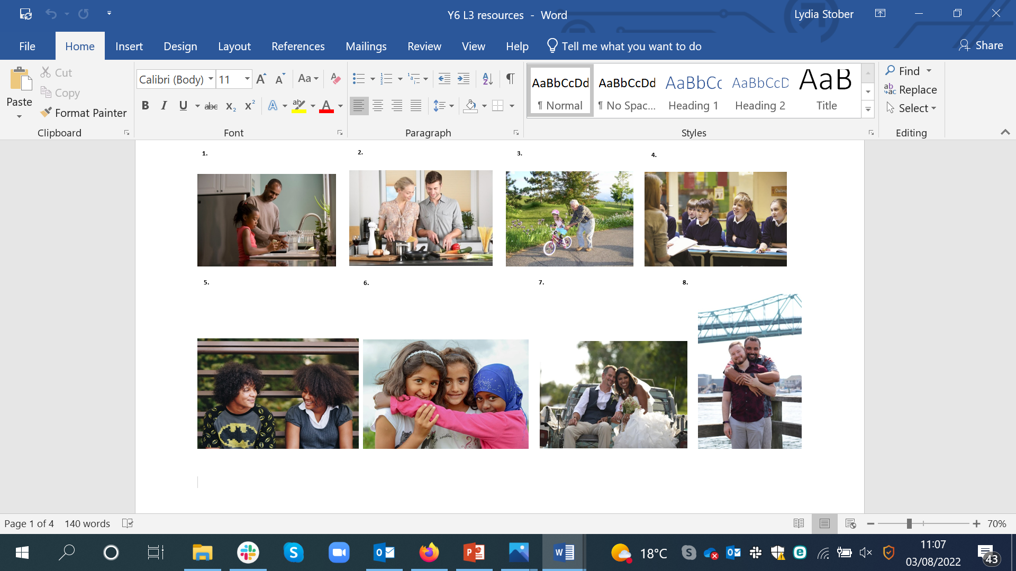
Different relationships
Discuss all the different types of relationship you see.
Can you think of any other relationship types?

Slide 6
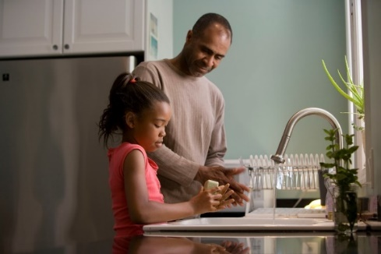
Relationship qualities
Choose one of the pictures.
What would the relationship need to make it positive and healthy?
What kinds of things might they do for each other?

Slide 7
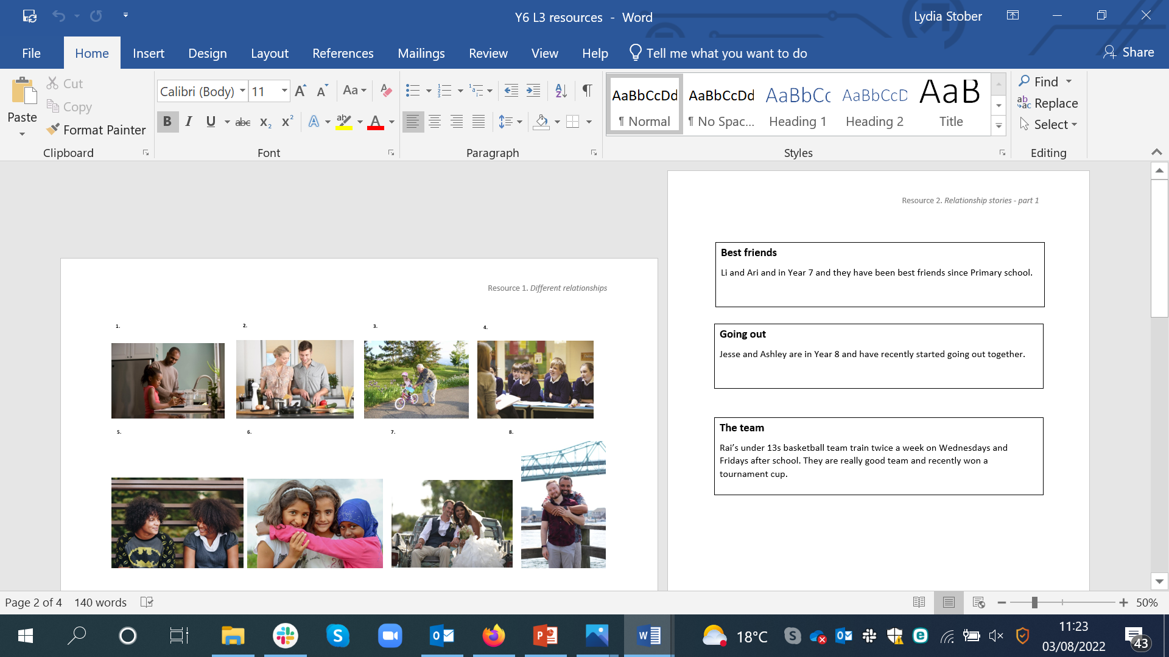


Relationship stories part 1
With your group, read the relationship story. Discuss how the characters should behave to keep the relationship positive and healthy.
1. How might the characters feel when they are together?
2. How might they speak to each other?
3. What sorts of things might they do together?
4. What boundaries (limits) might be important for these characters?

Slide 8
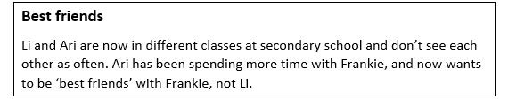


Relationship stories part 2
Sometimes relationships may change, what might cause this?
Now read part 2 of the relationship story.
How are the characters feeling now?
How can they manage the change that is happening?
What might happen in the future?

Slide 9
Reflection
A loving/positive relationship needs…..

Slide 10

What has been learnt?
Go back to your sentences from the beginning of the lesson.
Make any changes to your ideas if you want to.
Add your new learning from the lesson.
Use a different colour pen or pencil.

Slide 11
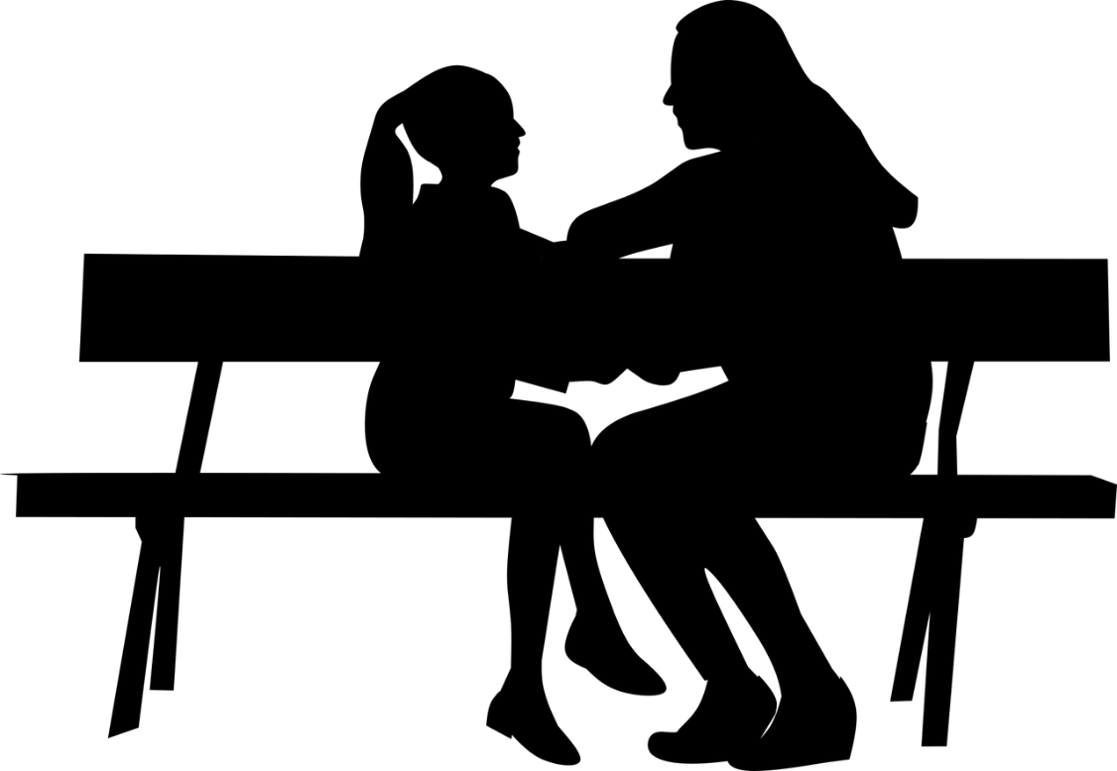
Signposting support
If you have any questions or worries about relationships, it is important to speak to a trusted adult – a parent/carer or teacher at school.
www.childline.org.uk can provide support too (phone 0800 1111 to talk to someone).

Slide 12
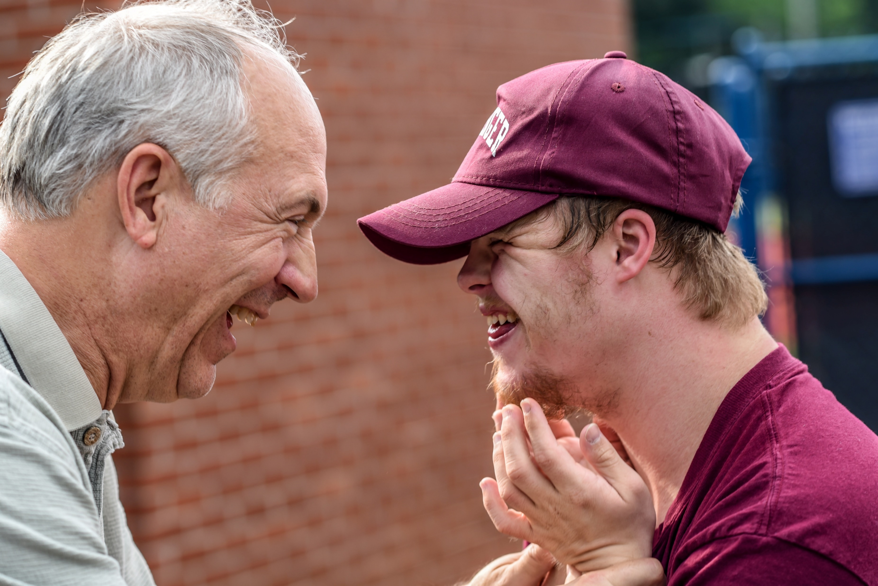
More activities
Different relationships
What different relationships might someone have at different stages of their life?
For example, as a child, teenager and adult.
For each, write down the qualities of the relationship, and what makes it positive and healthy.

